Slide 1

CG project
Presented to:
Dr. Omniah Nagoor

Slide 2
Reflection
Maisa Al-Zahrani 443006069
Jana Mohammed 443005920
Sarah Al-Oufi 443006431
Hamida Khan 441017934
Sawsan Elhams 443017467
Aghid Al-Ansari 443009096

Slide 3
Reflection
Maisa Al-Zahrani 443006069
Jana Mohammed 443005920
Sarah Al-Oufi 443006431
Hamida Khan 441017934
Sawsan Elhams 443017467
Aghid Al-Ansari 443009096

Slide 4
Reflection
Maisa Al-Zahrani 443006069
Jana Mohammed 443005920
Sarah Al-Oufi 443006431
Hamida Khan 441017934
Sawsan Elhams 443017467
Aghid Al-Ansari 443009096

Slide 5
Reflection
Maisa Al-Zahrani 443006069
Jana Mohammed 443005920
Sarah Al-Oufi 443006431
Hamida Khan 441017934
Sawsan Elhams 443017467
Aghid Al-Ansari 443009096

Slide 6
Reflection
Maisa Al-Zahrani 443006069
Jana Mohammed 443005920
Sarah Al-Oufi 443006431
Hamida Khan 441017934
Sawsan Elhams 443017467
Aghid Al-Ansari 443009096

Slide 7
Reflection
Maisa Al-Zahrani 443006069
Jana Mohammed 443005920
Sarah Al-Oufi 443006431
Hamida Khan 441017934
Sawsan Elhams 443017467
Aghid Al-Ansari 443009096

Slide 8
Reflection
Maisa Al-Zahrani 443006069
Jana Mohammed 443005920
Sarah Al-Oufi 443006431
Hamida Khan 441017934
Sawsan Elhams 443017467
Aghid Al-Ansari 443009096

Slide 9
Reflection
Maisa Al-Zahrani 443006069
Jana Mohammed 443005920
Sarah Al-Oufi 443006431
Hamida Khan 441017934
Sawsan Elhams 443017467
Aghid Al-Ansari 443009096

Slide 10






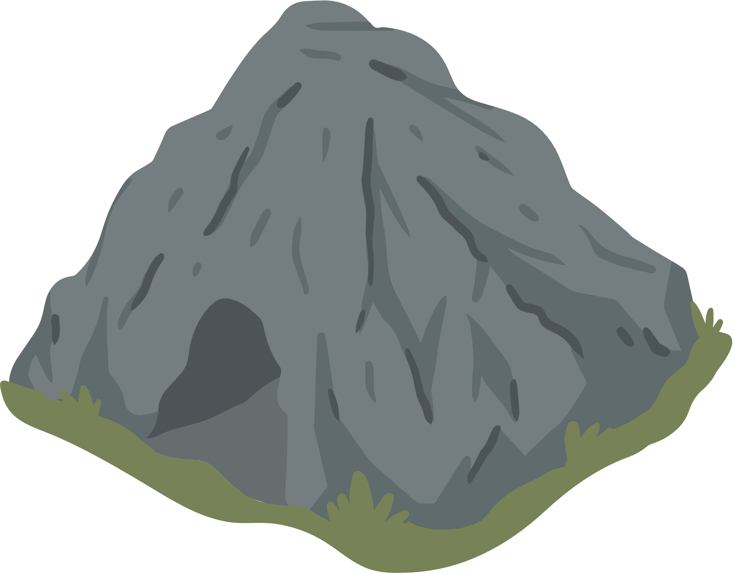






Slide 11
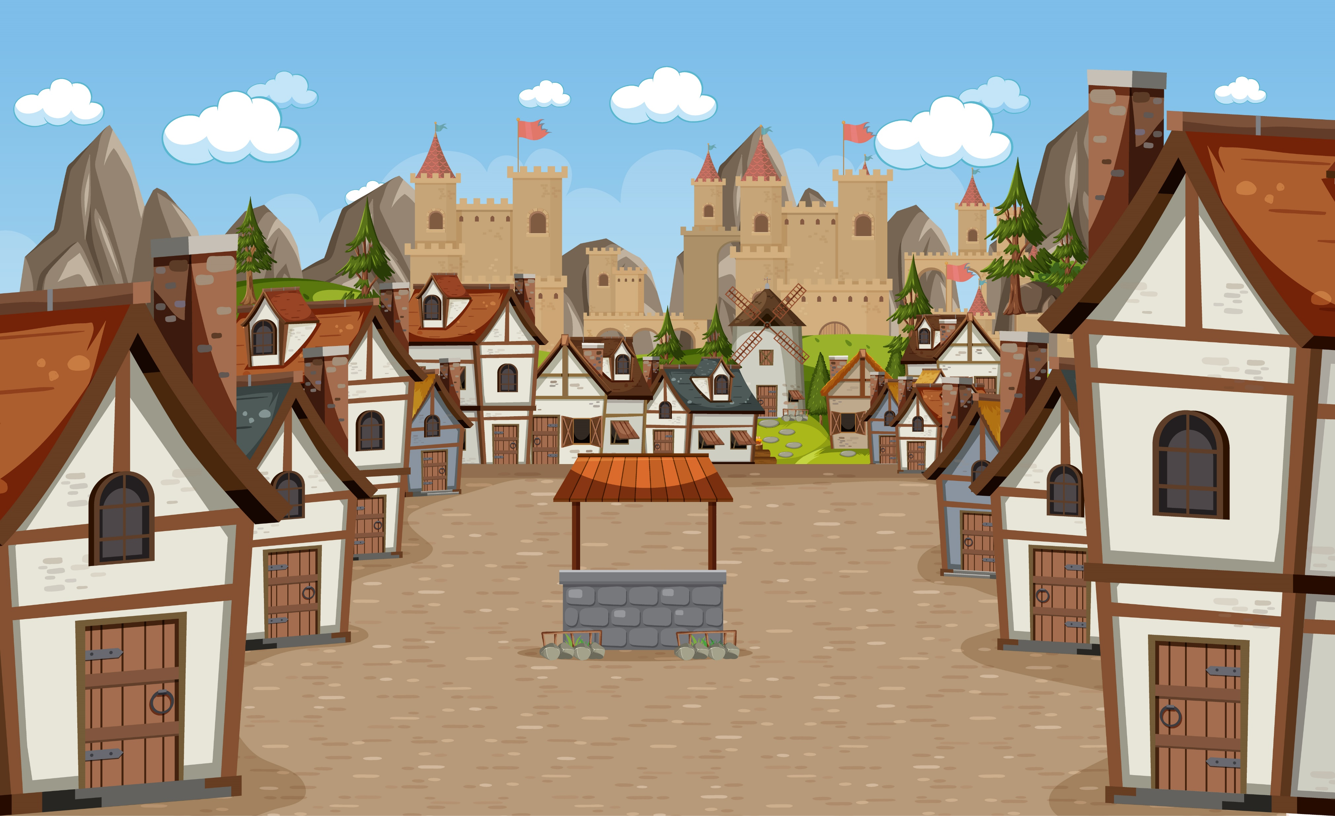


Did you hear about it?!
The “4 seasons world” !?

Slide 12
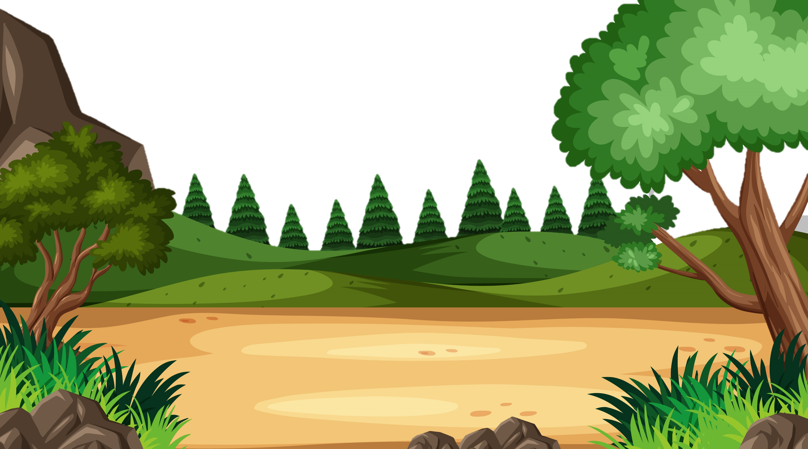
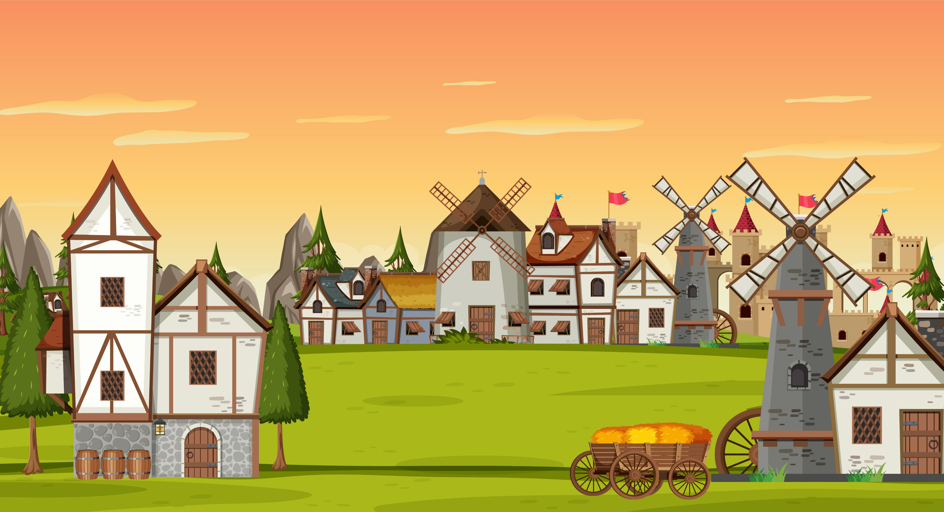
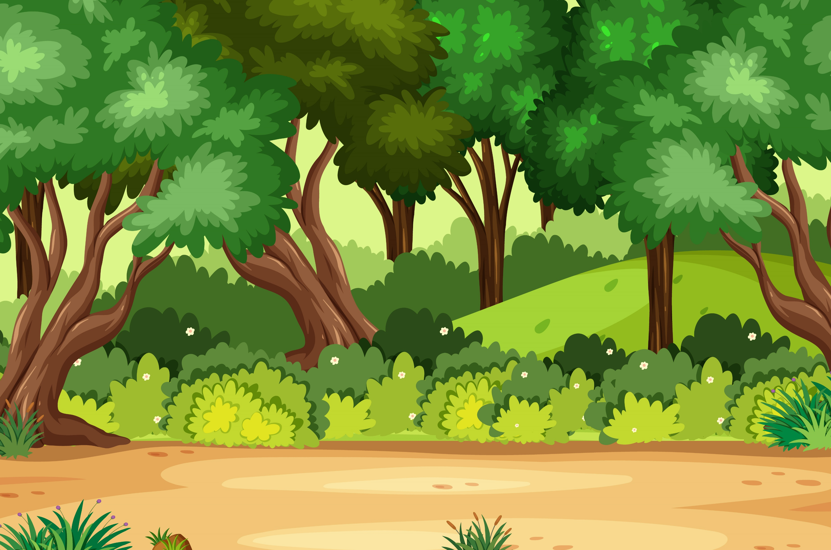

Slide 13
What a thrill !

Slide 15
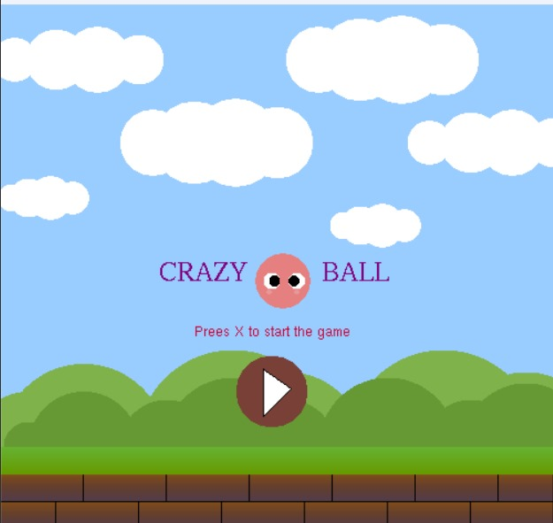

Slide 16
!!!

Slide 18
CRAZY
BALL
Press S to start the game

Slide 19
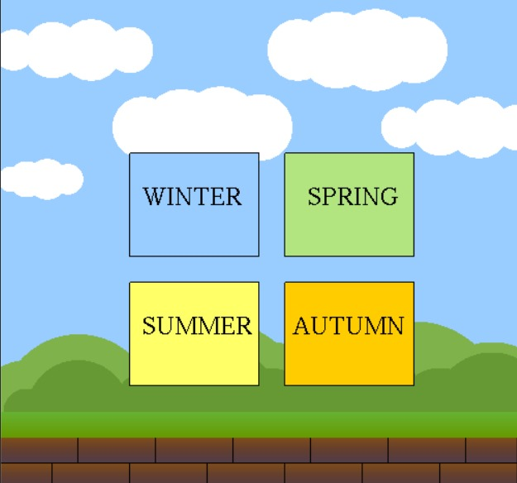

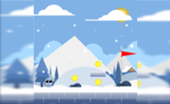
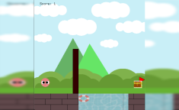
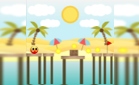
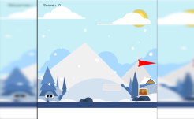
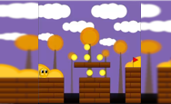
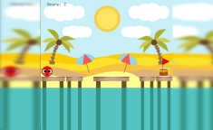
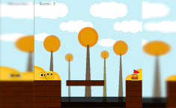


Slide 20
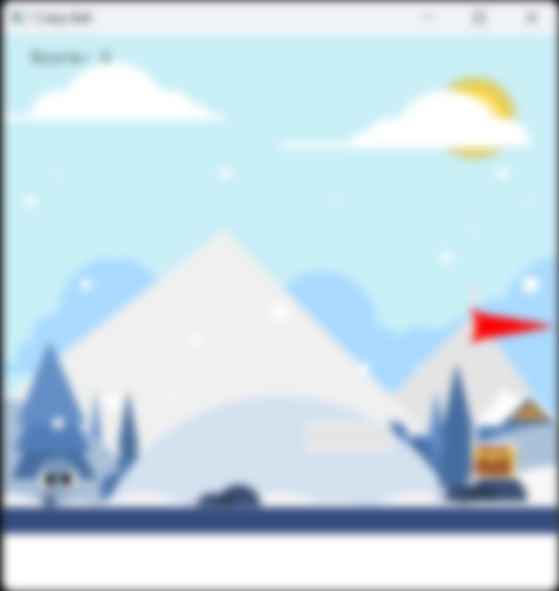
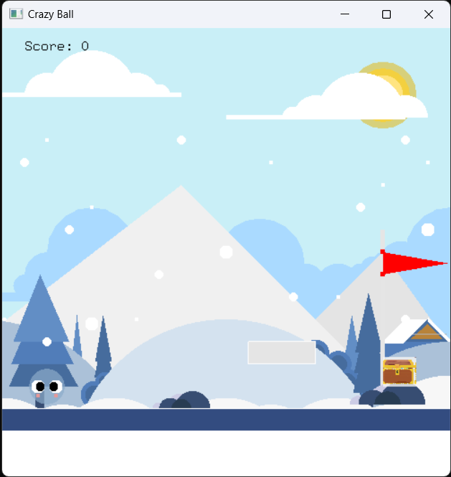

Slide 21
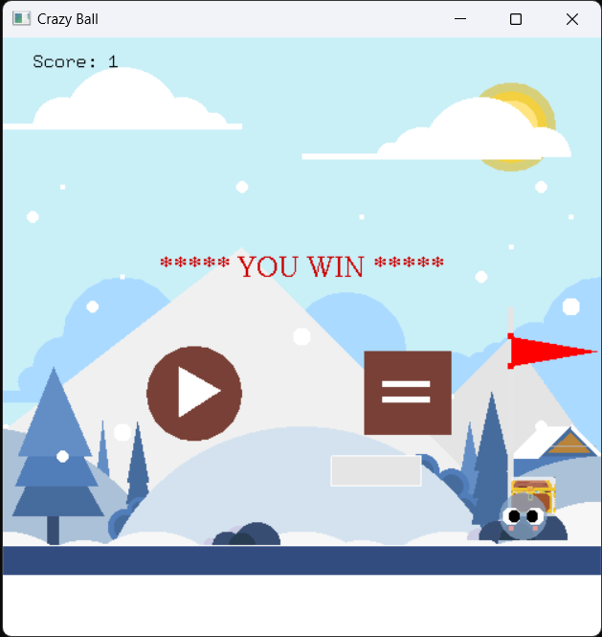

Slide 22
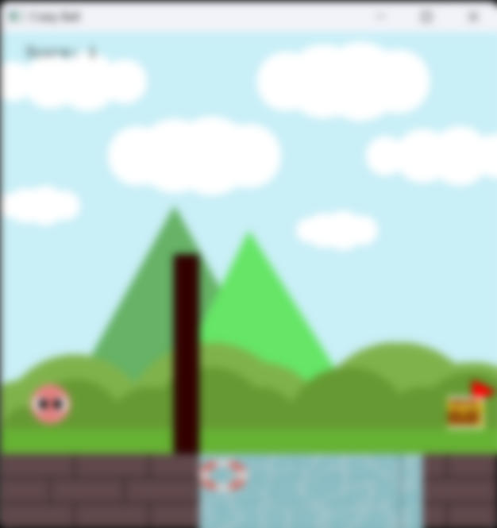
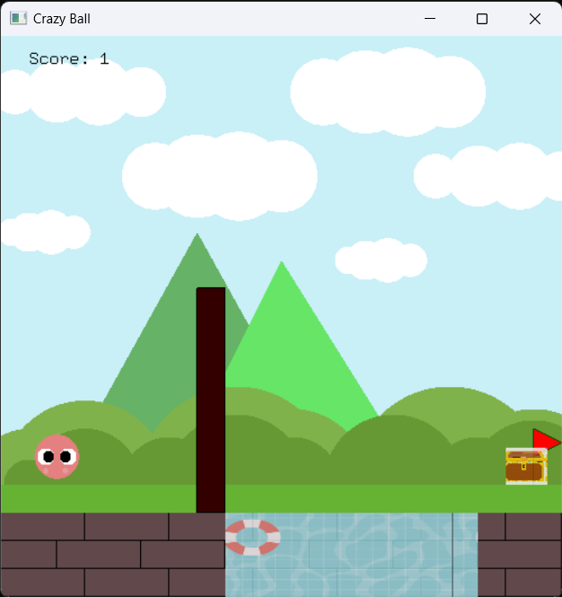

Slide 23
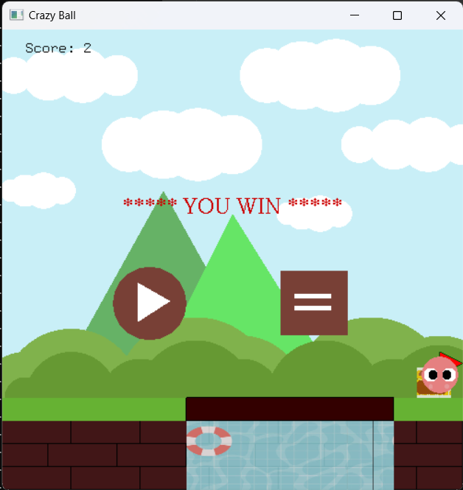

Slide 24
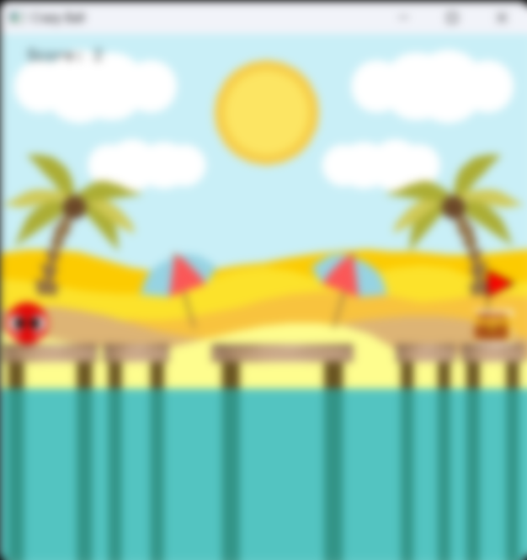
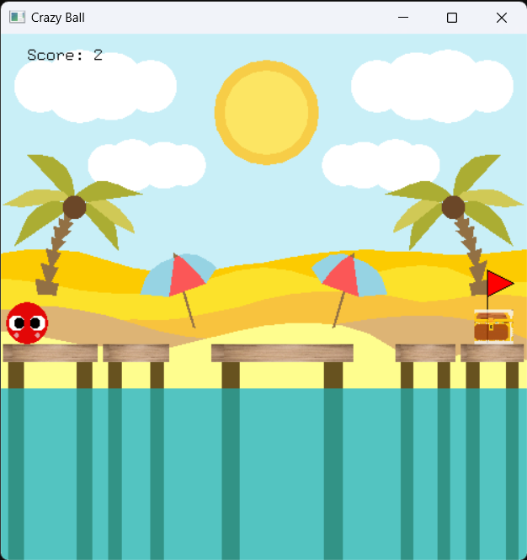

Slide 25
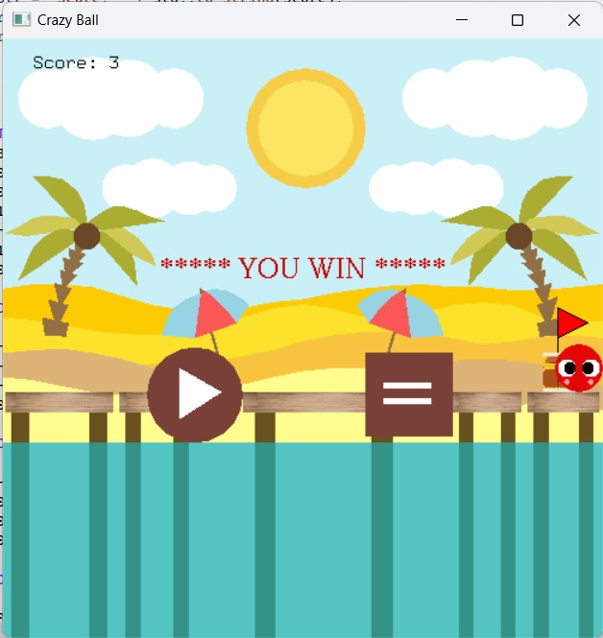

Slide 26
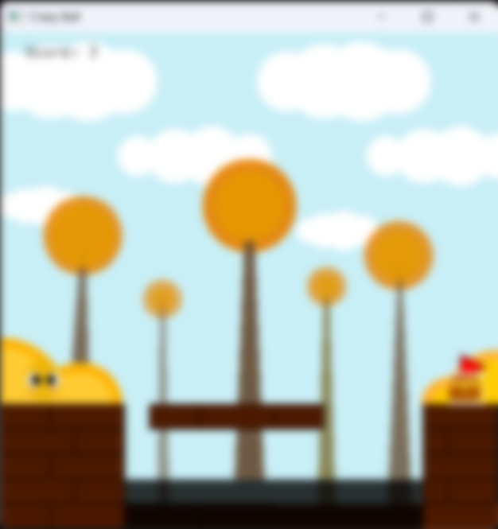
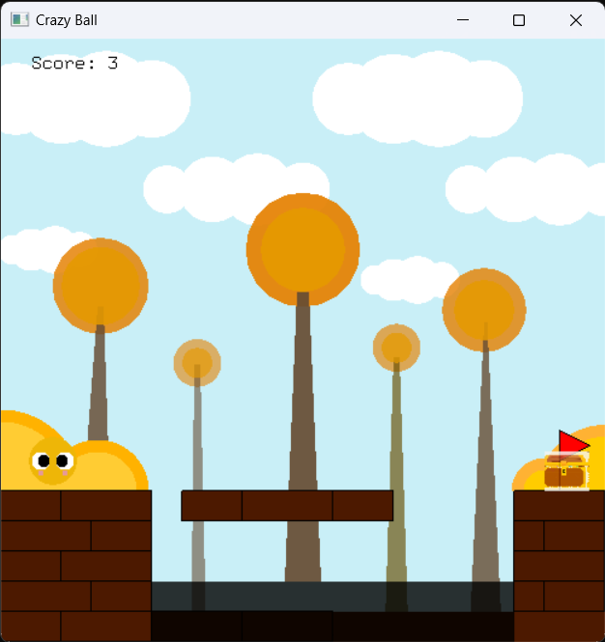

Slide 27
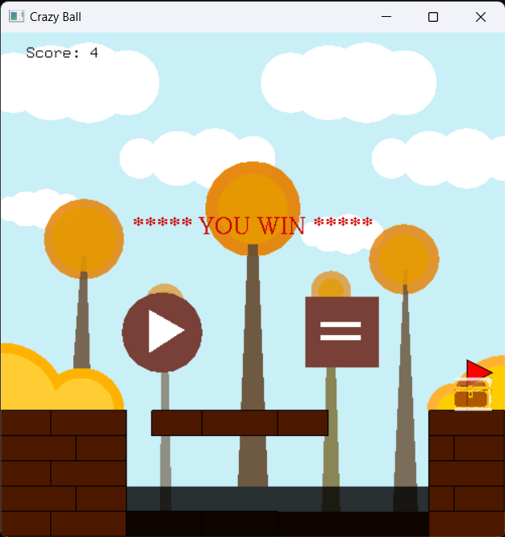

Slide 28


Slide 31
The End

Slide 32
The End

Slide 33
